Slide 2
Bird
Calls

Slide 3
Selfies

Slide 4
Bird
Facts

Slide 5
Black
Oystercatchers

Slide 6
All About
Chicks

Slide 7
Ancient
Murrelets

Slide 8
Bird Sounds
Bird Selfies
Bird Facts
Black
Oystercatchers
All about
Chicks
Ancient
Murrelets
$100
$100
$100
$100
$100
$100
$200
$200
$200
$200
$200
$200
$300
$300
$300
$300
$300
$300
$400
$400
$400
$400
$400
$400
$500
$500
$500
$500
$500
$500

Slide 10
What is a Bald Eagle?

Slide 12
What is the American
Robin?

Slide 14
What is a Crane?

Slide 16
What is a Black Oystercatcher?

Slide 18
What is a Pigeon
Guillemot?

Slide 19
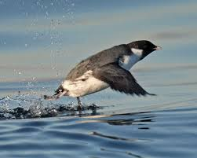

Slide 20
What is an Ancient
Murrelet?

Slide 21
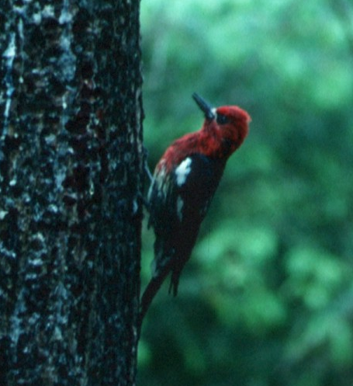

Slide 22
What is a Red Breasted
Sapsucker?

Slide 23
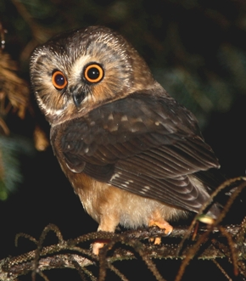

Slide 24
What is a Saw Whet
Owl?

Slide 25
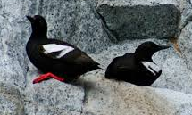

Slide 26
What is a Pigeon
Guillemot?

Slide 27
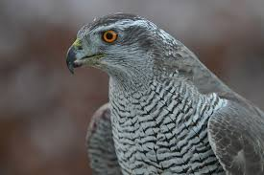

Slide 28
What is a Northern
Goshawk?

Slide 29
Birds are
__________
blooded

Slide 30
What is Warm?

Slide 31
True or false: All Birds can fly

Slide 32
What is
False?

Slide 33
Birds do this to get away
from the cold weather

Slide 34
What is
Migrate?

Slide 35
In order to fly,
birds have this
kind of bones

Slide 36
What are
Hollow
Bones?

Slide 37
This bird has the
largest brain compared
to it’s body size

Slide 38
What is a
Crow?

Slide 39
4 letter species code for
Black Oystercatcher

Slide 40
What is a
BLOY?

Slide 41
Black Oystercatcher
nests are
made of this

Slide 42
What are
Rocks and sea shells?

Slide 43
This is what their
Nests are called?

Slide 44
What is a
Scrape?

Slide 45
This is what their
main diet
consists of

Slide 46
What are Mussels,
Limpets,
Chitons?

Slide 47
This is where they
Spend most of
their time

Slide 48
What is the
Intertidal zone?

Slide 49
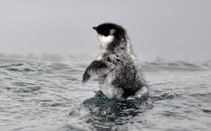

Slide 50
Ancient
Murrelet

Slide 51
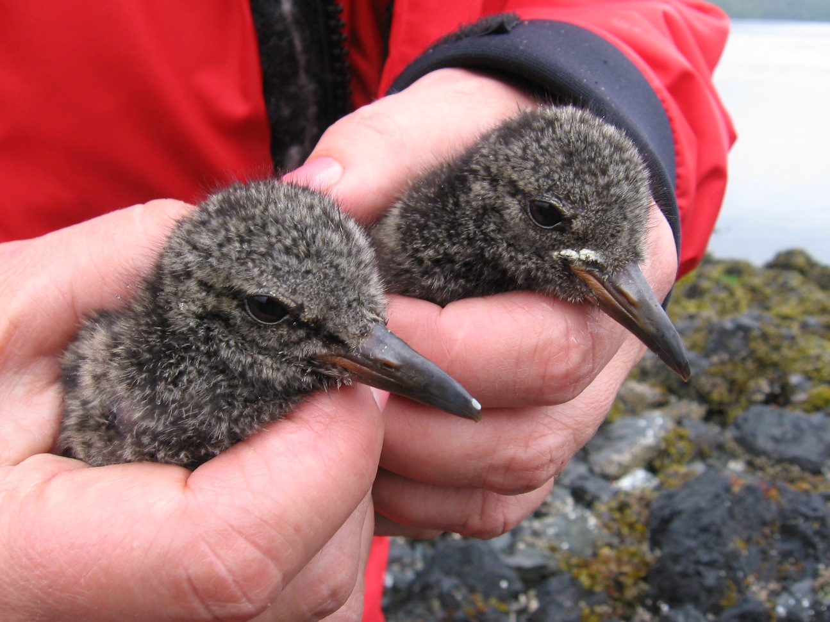

Slide 52
What are Black
Oystercatcher chicks?

Slide 53
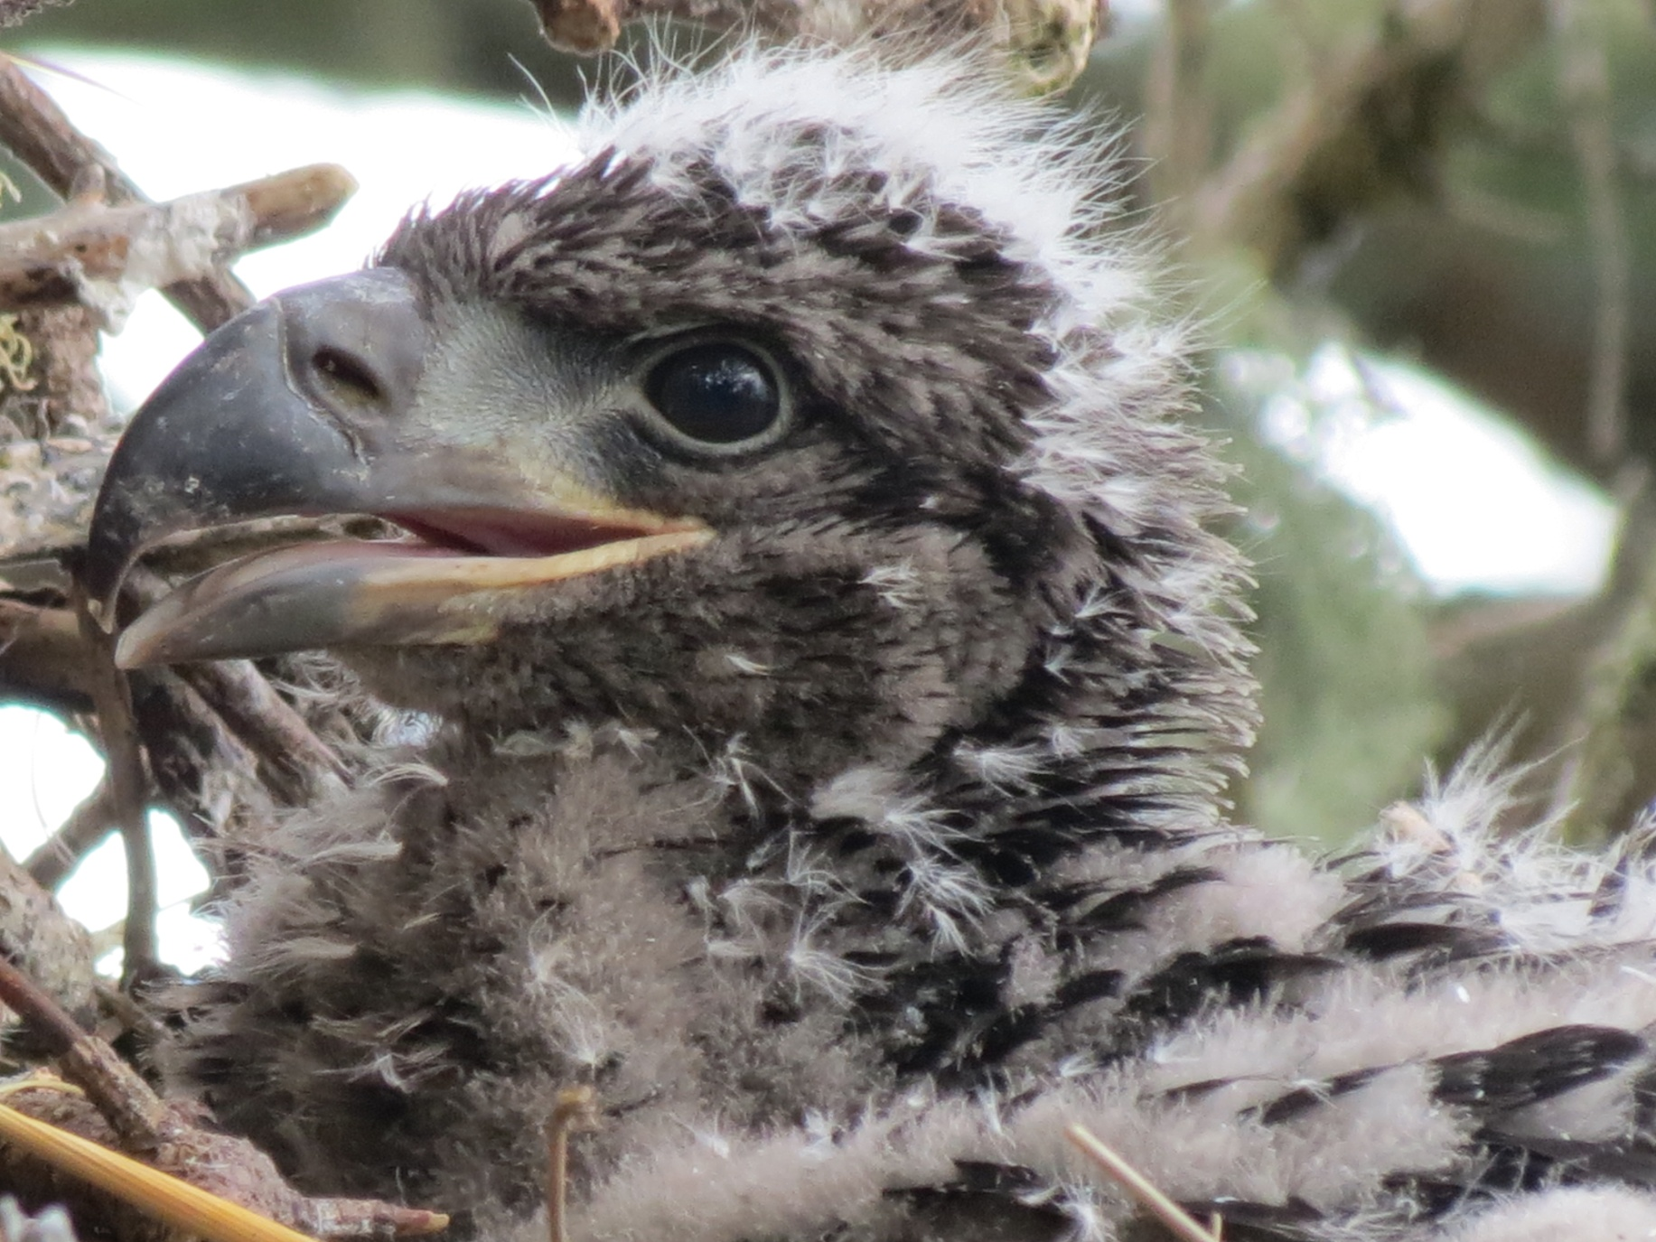

Slide 54
What is a
Bald Eagle chick?

Slide 55
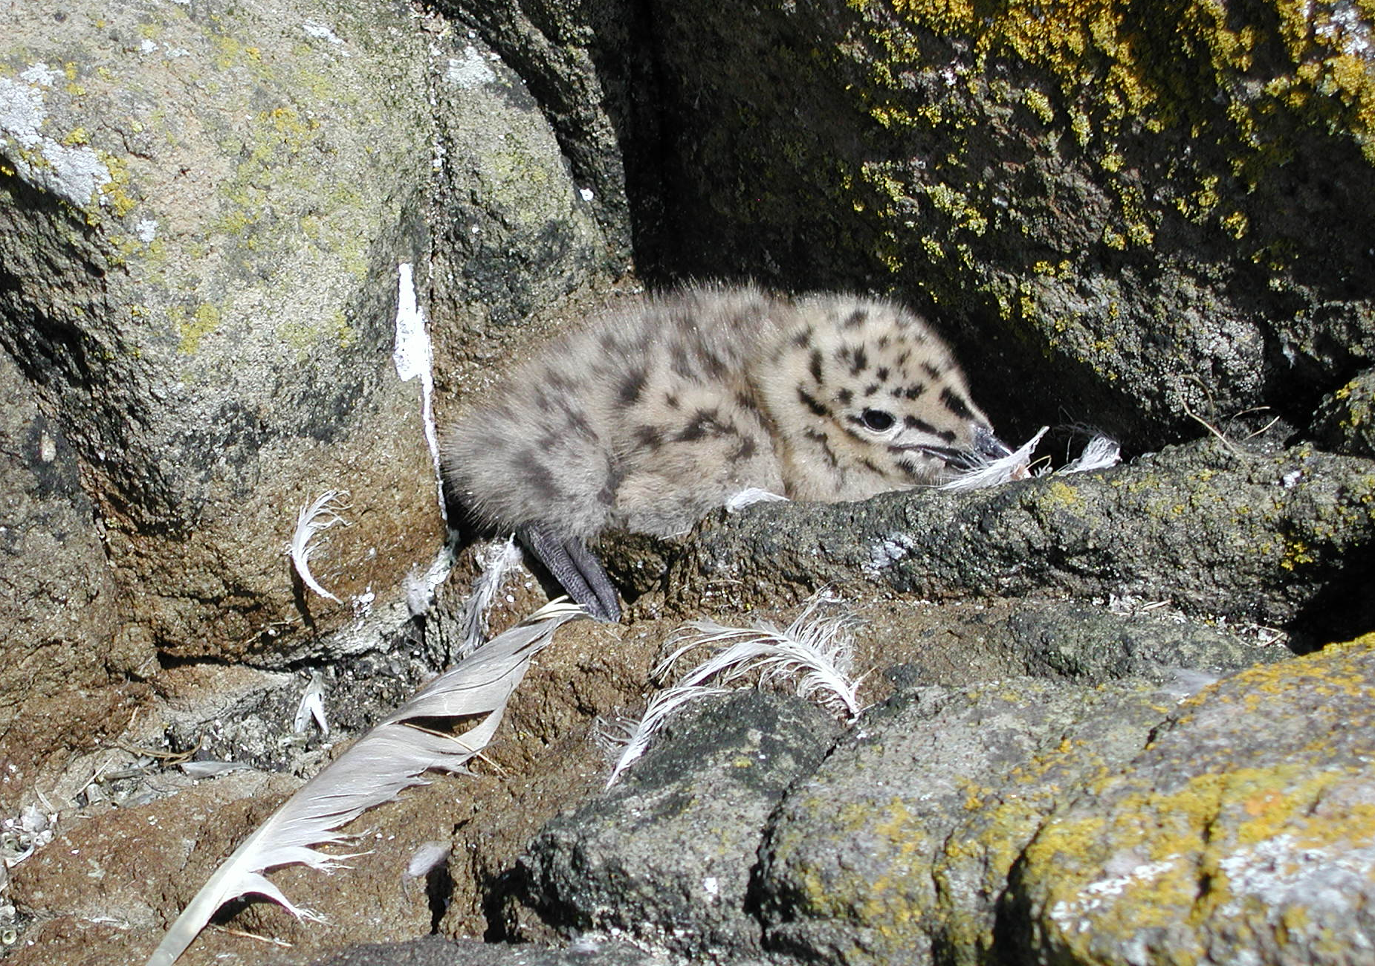

Slide 56
What is a
Glaucous-winged
Gull chick?

Slide 57
Daily
Double!!

Slide 58
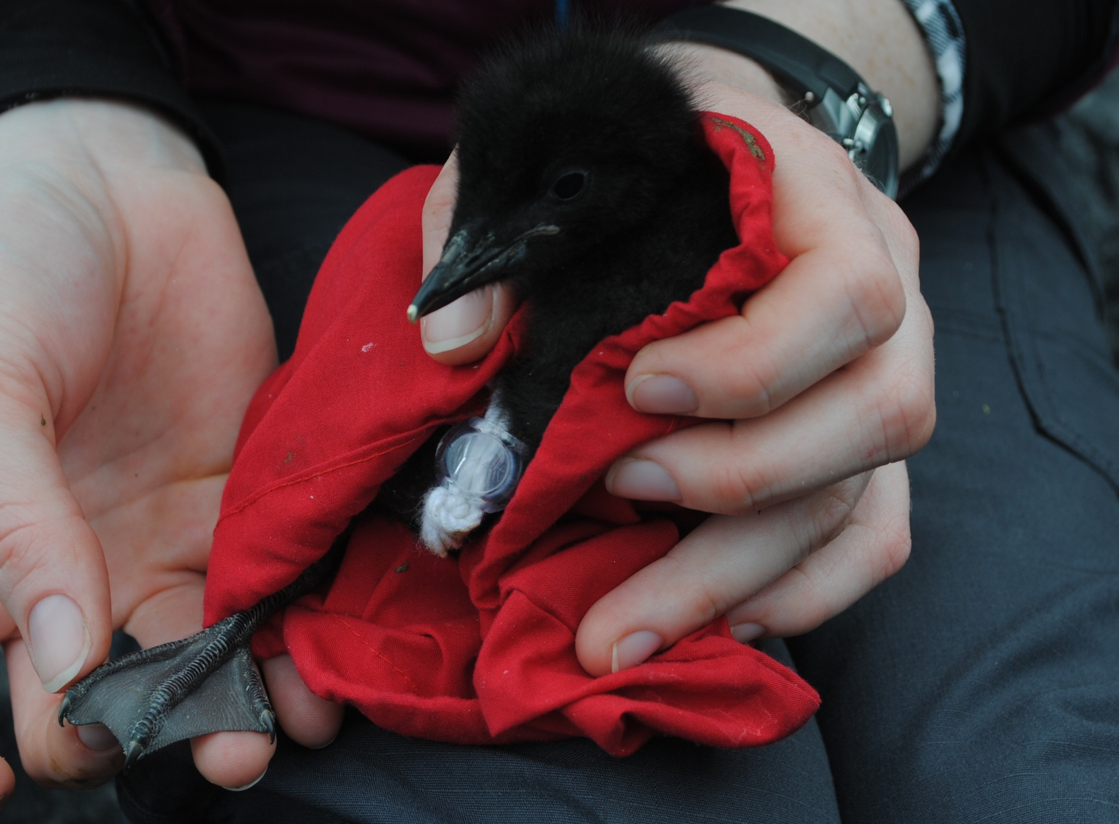

Slide 59
What is a Pigeon
Guillemot chick?

Slide 60
This is where they
make their nests

Slide 61
What is
the Forest?

Slide 62
This is what chicks are born
with to help them
run through the forest
at only 2 days old

Slide 63
What are
Adult Feet?

Slide 64
This is how many eggs
a female lays per season

Slide 65
What is two?

Slide 66
This is the % of
body weight
that each egg weighs

Slide 67
What is 25% of
the females’
body weight?

Slide 68
Age of the
oldest known
Ancient Murrelet

Slide 69
What is
25 years?

